Slide 1
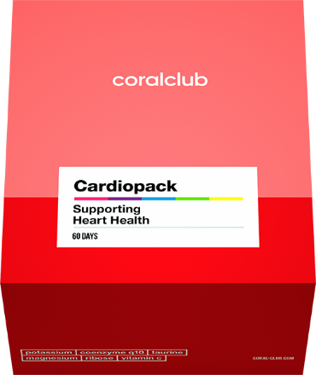
CardioPack
SUPPORTING HEART HEALTH

Slide 2
Cardiovascular
system
HEART
THE Cardiovascular system is a network
consisting of blood, blood vessels
and the heart.
This network supplies tissues in the
body with oxygen and other nutrients.
VESSELS
Circulation — is the process by which the heart pumps a
person's blood around their body.
Notes:
Let’s talk about your heart. The heart is the only organ that begins to work even before you are born. It begins beating four weeks after conception and does not stop until death. We use the word “heart” in so many expressions: “a heart of gold”, “thank someone from the bottom of your heart”, “have a heavy heart”. When you’re in love, your heartbeat quickens, and when you’re scared, it makes your blood run cold. However, it works both ways: the heart depends on us, and we depend on it. The way that we care about our heart’s health affects the quality and length of our life.

Slide 3
The heart copes with
a lot of stress
It pumps about
7-10
tons of blood
IT BEATS
100 000
PER DAY
It produces as much
energy as a truck
would need
to travel
32 km
It provides blood to all
75 TRILLION
cells IN OUR BODY
Notes:
The heart of an adult beats approximately
72 times per minute
100,000 times per day
36.5 million times per year
3.3 billion times over a lifetime
The heart provides blood to all 75 trillion body cells. Throughout an average lifespan, the heart pumps approximately 5.7 million litres of blood.

Slide 4
Factors THAT adversely affect the heart:
High blood pressure
Smoking
Unbalanced diet and excessive
weight
Sedentary lifestyle
Water imbalance
Stress and psycho-emotional pressure
Diabetes
Hereditary problems
Bad ecology
Age
Notes:
The World Health Organization (WHO) identifies three main risk factors for acute cardiovascular disease: hypertension, high blood cholesterol, and smoking.
As an example, excessive and constant smoking doubles the likelihood of developing cardiovascular disease.
Risk factors also include:
• Alcohol abuse. It increases blood pressure and blood viscosity. Alcohol removes magnesium from your body, which is crucial for the heart muscle’s activity.
• Gender. It is proven that men suffer from myocardial infarction more often than women. The risk of developing cardiovascular disease in women increases during menopause due to decreasing estrogen levels – estrogen has a protective effect on the cardiovascular system.
• Excessive consumption of trans fats. These trans fats are saturated fats, contained in large quantities in animal products, red meat, margarine, confectionery, and fried foods. The more trans fats there are in your diet, the higher is the level of bad cholesterol in your body.
• Salt. Sodium is the main component of salt. The balance of potassium and sodium in the body maintains the water level inside cells. This balance is also responsible for the absorption and excretion of nutrients, as well as for the excretion of decay products. Adding salt to food upsets this balance and causes blood pressure to increase.

Slide 5
heart muscle wear
damage to the walls of arteries and blood vessels
Formation of blood clots
Increased blood pressure
Constant
stress
+
=
NEGATIVE
FACTORS
risk of coronary heart disease,
myocardial infarction, strokes
Notes:
Risk factors affect the likelihood of developing cardiovascular disease:
- increased blood pressure leads to damage of blood vessels
- stress leads to blood thickening and the risk of thrombosis
- high cholesterol level leads to the formation of fat cells deposits (cholesterol) on the blood vessels walls
- excessive weight creates an additional burden on the body and the heart
- excessive blood sugar level leads to impaired blood circulation and vasoconstriction

Slide 6
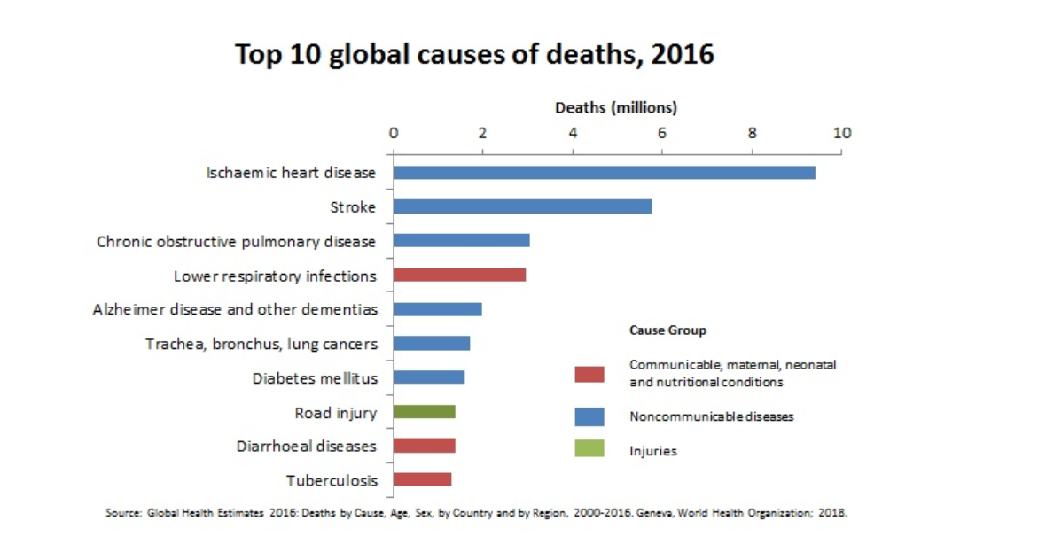
The heart needs care
Заболевания сердечно-сосудистой системы — главная причина смертности в мире
*WHO data
Notes:
Most people don’t think about their health until there is a problem. Did you know that more people have died from heart disease than from all the wars during the whole history of mankind?
Cardiovascular disease has a huge problem worldwide. It has reached epidemic proportions.

Slide 7
For the proper functioning
of the cardiovascular system
you have to:
Monitor your
water balance
and nutrition
Have an ACTIVE
lifestyle,
play sports
GIVE UP BAD HABBITS
REDUCE STRESS
AND EMOTIONAL
PRESSURE
Support the body
With nutrients
That are good for
your heart
Notes:
It can be difficult to do all the right things to keep your heart healthy, especially keeping track of all the nutrients that are beneficial for the heart.

Slide 8
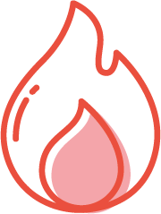
Nutrients beneficial
FOR HEART HEALTH
POTASSIUM
to support water-salt balance
TAURINE
to strengthen heart
muscles
Coenzyme Q10
to boost energy
Magnesium
to lower the risk of heart problems
Notes:
The action of the components to maintain heart’s health is like removing a heavy load from a horse with your caring hand, making it easier for her to run. Over the course of 80 years of life, your heart beats about 3.3 billion times. Imagine how much energy it needs and think about how much wear and tear the heart muscle is subject to. Potassium and coenzyme provide the heart with energy. Taurine regulates the exchange of important heart minerals: potassium, magnesium, calcium. Magnesium improves coronary blood flow and reduces stress, helps to maintain normal heart rate.

Slide 9
Everything your heart
needs in one box!
Coral Club experts have developed this set
for heart health tailored to the requirements of
the cardiovascular system.
Enhancing each other’s effect,
the nutrients in this set have
A maximum synergistic effect:
they strengthen the heart muscle
saturate heart cells with extra energy
ensure a healthy heart rate
Notes:
Cardiopack has a healing effect and helps to reduce the risk of developing cardiovascular problems.

Slide 10
SYNERGY OF COMPONENTS
Taurine + Coenzyme Q10
to maintain heart energy
Potassium + Magnesium
to maintain a normal heart rate
Potassium + Magnesium + Taurine + Coenzyme Q10
to maintain heart health
Notes:
For best absorption, compatibility and synergy of the components are important.

Slide 11
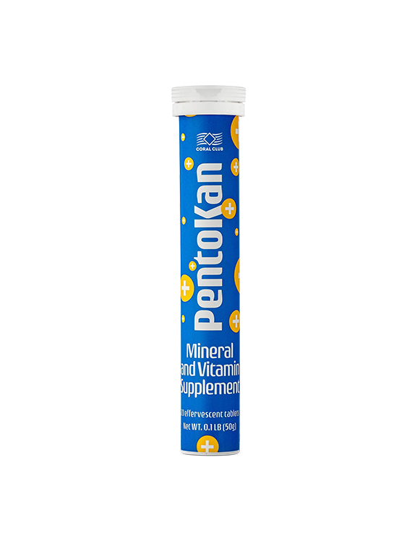
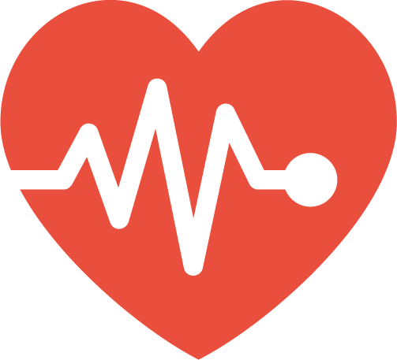
PENTOKAN —
CELLULAR ENERGY
Supports heart performance
Ensures the proper functioning of the Sodium-Potassium pump
Helps to stabilize the heart rate
Effervescent tablets ensure bioavailability
of potassium
INGREDIENTS (1 tablet):
Potassium ......420 mg
Vitamin C……..100 mg
Ribose ............20 mg
Notes:
PentoKan is a product that was created specifically to prevent the lack of potassium in the cell - the “building block” of the body, which will guarantee healthy and proper functioning of the cell. PentoKan creates the optimal environment for replenishing the cell’s energy resources, ensures the proper functioning of the Sodium-Potassium pump and maintains the viability of the cell, even in times of oxidative stress. Potassium helps to increase muscle stamina (the heart is a muscle).

Slide 12
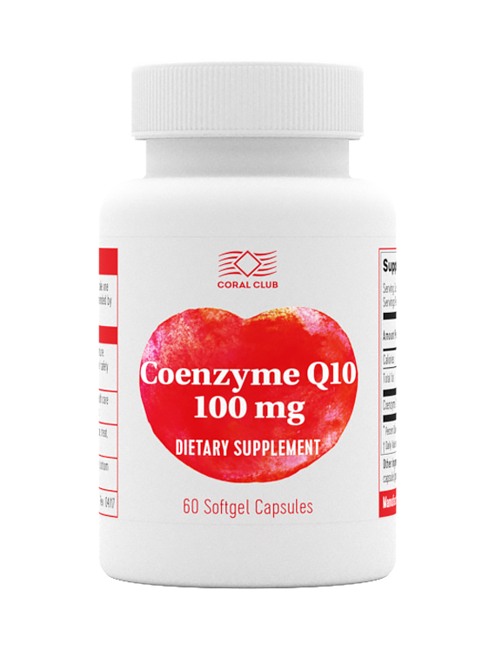
Coenzyme Q10 -
heart protection
from aging
Coenzyme Q10 is beneficial for heart health
Helps to slow down the aging process of cells
Helps to boost energy and speeds up recovery after strenuous physical activity
INGREDIENTS (1 capsule):
Coenzyme Q10 ……..100 mg
Notes:
Coenzyme Q10 is part of the mitochondria cells that generate about 95% of all the energy in the human body. With age, the body gradually loses its ability to synthesize this coenzyme. This coenzyme normalizes the function of these organs, improves physical endurance and slows down aging.

Slide 13
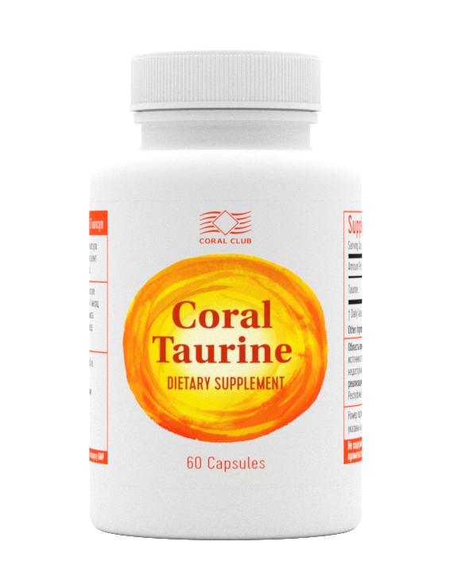
Coral Taurine - Healthy HEART beat
Helps in regulation of cardiac contraction by balancing
concentration of minerals
Helps to increase blood flow and circulation
Helps to lower cholesterol
Supports normal heart rate
ingredients (1 Capsule):
Taurine ………..600 mg
Notes:
Taurine is a highly bioactive amino acid that is necessary for overall health. It is found in almost every vital organ of the body, regardless of a person’s age.
Sources of taurine are entirely of animal origin (meat, eggs, milk, fish, and seafood). In the human body, taurine is a derivative of another amino acid called cysteine, and its synthesis significantly decreases with age. That is why vegetarians and people over 40 should take measures to maintain their taurine levels.

Slide 14
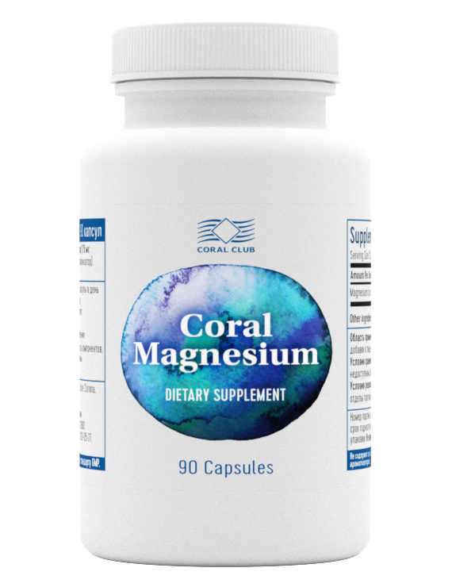
Coral Magnesium –
ANTISTRESS
Regulates muscle tone and heart rate
Has a calming effect on the nervous system
Improves coronary blood flow
Prevents the appearance of cholesterol plaques on the
walls of blood vessels.
Coral Magnesium is a specially designed mineral complex containing
Magnesium taurate (an organic compound of taurine amino acid) and
glycinate (organic compound of glycine amino acid).
Such organic forms of magnesium are especially beneficial due to synergetic
effects of these combined ingredients that magnify their benefits.
Ingredients (1 capsule):
Magnesium (taurate) .........75 mg
Magnesium (bisglycinate) ..75 mg
Notes:
Magnesium may be one of the most vital nutrients the body needs that supports cardiovascular health. Magnesium deficits have been linked with a long list of cardiovascular issues: high blood pressure, heart rhythm problems and others.
Coral Magnesium contains magnesium glycinate and magnesium taurate. This dietary supplement actively supports cardiovascular health and neuromuscular tissue function.
The product contributes to the synthesis of enzymes, it normalizes metabolism, and actively regulates the calcium and sodium balance on a cellular level.

Slide 15
CardioPack :
source of
additional
energy for the heart
normalized Blood pressure
and heart
rate
Helps protect the cardiovascular system
Notes:
With the help of CardioPack, keep your heart health in check!

Slide 16
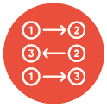
Coral Club PACKS
SYNERGY
Enhanced
action of
components
Convenience
Simple and convenient
VALUE
Great products at a great price
Notes:
The heart is an organ that performs many tasks, and a comprehensive multi-faceted approach is necessary to keep it healthy. Coral Club’s experts have selected a set of products that combines all the necessary components, considering their individual effects, their compatibility and synergistic effect. Enclosed, you will find clear directions for the entire administration period of 60 days. The pack is offered at a reduced price, compared to purchasing the products separately.

Slide 17
Сardiopack
VOLUME POINTS
MEMBER PRICE
RETAIL PRICE
57
$95 USD
$118.75 USD

Slide 18
From the bottom of our heart,

